Slide 1
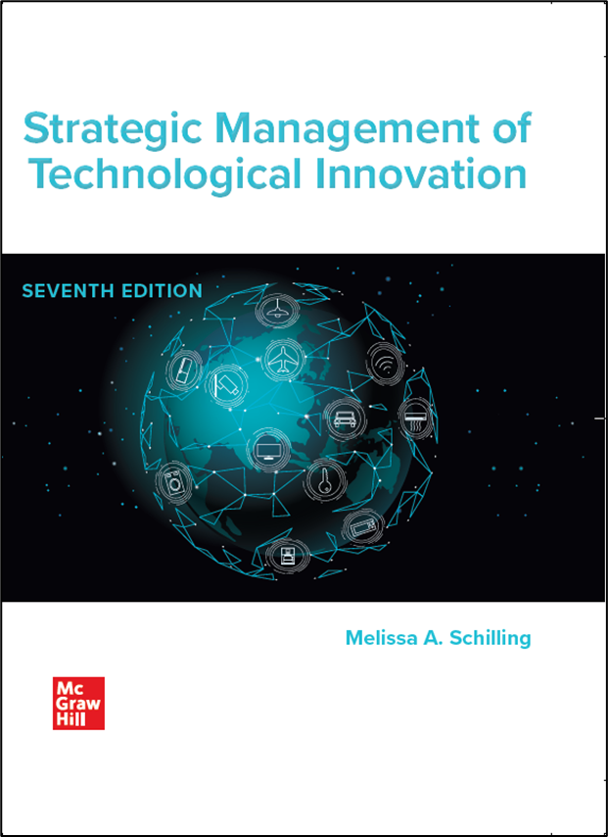
Chapter 1
Introduction
Strategic Management of Technological Innovation, 7th Edition
Melissa A. Schilling
© McGraw Hill LLC. All rights reserved. No reproduction or distribution without the prior written consent of McGraw Hill LLC.

Slide 2
Importance of Technological Innovation 1
Technological innovation now the single most important driver of competitive success in many industries.
Many firms earn over one-third of sales on products developed within last five years.
Product innovations help firms protect margins by offering new, differentiated features.
Process innovations help make manufacturing more efficient.

Slide 3
Importance of Technological Innovation 2
Advances in information technology have enabled faster innovation.
C A D/C A M systems enable rapid design and shorter production runs.
Importance of innovation and advances in information technology have lead to:
Shorter product lifecycles (more rapid product obsolescence).
More rapid new product introductions.
Greater market segmentation.

Slide 4
Impact on Society
Innovation enables a wider range of goods and services to be delivered to people worldwide.
More efficient food production, improved medical technologies, better transportation, etc.
Increases Gross Domestic Product by making labor and capital more effective and efficient.
However, may result in negative externalities.
For example, pollution, erosion, antibiotic-resistant bacteria.

Slide 5
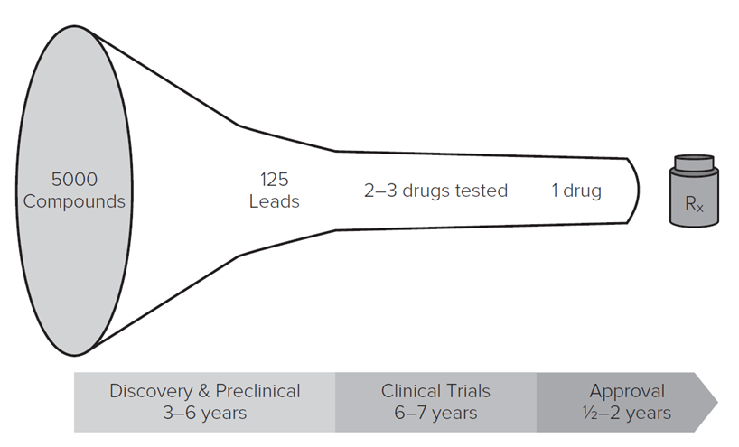
Innovation by Industry: The Importance of Strategy
Successful innovation requires carefully crafted strategies and implementation processes.
Innovation funnel.
Most innovative ideas do not become successful new products.
For example, The New Product Development Funnel in Pharmaceuticals.
Access the text alternative for these images

Slide 6
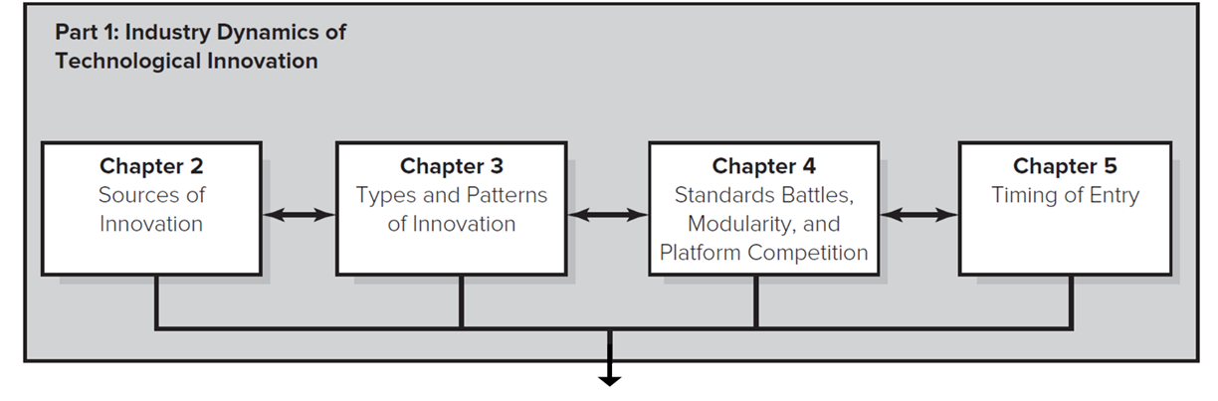
The Strategic Management of Technological Innovation 1
Part One: The foundations of technological Innovation.
Sources of innovation.
Types and patterns of innovation.
Standards battles and design dominance.
Timing of Entry.
Access the text alternative for these images

Slide 7
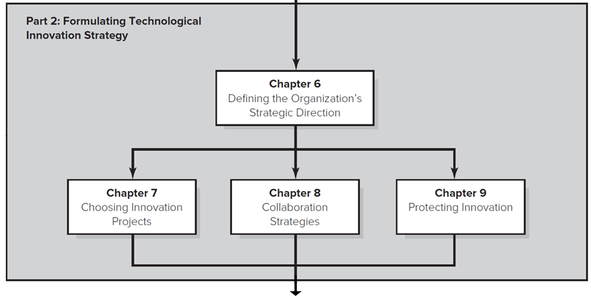
The Strategic Management of Technological Innovation 2
Part Two: Formulating Technological Innovation Strategy.
Defining the organization’s strategic direction.
Choosing innovation projects.
Collaboration strategies.
Protecting innovation.
Access the text alternative for these images

Slide 8
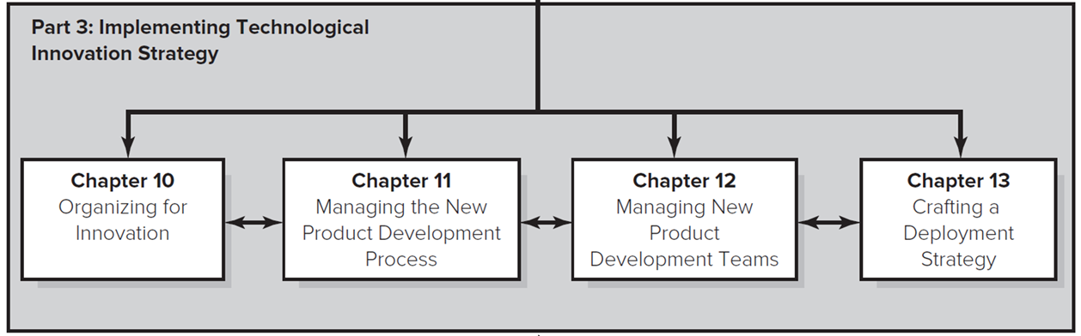
The Strategic Management of Technological Innovation 3
Part Three: Implementing Technological Innovation Strategy.
Organizing for innovation.
Managing the new product development process.
Managing new product development teams.
Crafting a deployment strategy.
Access the text alternative for these images

Slide 9
Discussion Questions
Why is innovation so important for firms to compete in many industries?
What are some of the advantages of technological innovation? Disadvantages?
Why do you think so many innovation projects fail to generate an economic return?

Slide 10
Part One: Industry Dynamics of Technological Innovation
The sources from which innovation arises, including the role of individuals, organizations, government institutions, and networks.
Types of innovations, and common industry patterns of technological evolution and diffusion.
The factors that determine whether industries experience pressure to select a dominant design, and what drives which technologies dominate others.
Effects of timing of entry, and how firms can identify (and manage) their entry options.

Slide 11
End of Main Content
© McGraw Hill LLC. All rights reserved. No reproduction or distribution without the prior written consent of McGraw Hill LLC.

Slide 12
Accessibility Content: Text Alternatives for Images

Slide 13
Innovation by Industry: The Importance of Strategy – Text Alternative
Return to parent-slide containing images.
An illustration shows the process involved in new product development in pharmaceuticals. The illustration is shaped like a funnel, which has been placed horizontally. The top part of the funnel is labeled as 5000 compounds, leading to the middle part labeled as 125 leads, leading to the bottom part labeled as 2 to 3 drugs tested and ending at the tip of the funnel labeled 1 drug. A bottle labeled R x is placed at the end of the funnel. A rightward pointing scale is placed at the bottom of the funnel and is divided into three sections. The first section is labeled discovery and preclinical, 3 to 6 years. The second section is labeled clinical trials, 6 to 7 years. The third section is labeled approval, half to 2 years.
Return to parent-slide containing images.

Slide 14
The Strategic Management of Technological Innovation 1 – Text Alternative
Return to parent-slide containing images.
Part 1, labeled Industry dynamics of technological innovation, contains Chapter 2, Sources of Innovation, Chapter 3, Types and patterns of Innovation, Chapter 4, Standards battles, modularity, and platform competition, and Chapter 5, Timing of entry.
Return to parent-slide containing images.

Slide 15
The Strategic Management of Technological Innovation 2 – Text Alternative
Return to parent-slide containing images.
Part 2, labeled Formulating technological innovation strategy, contains Chapter 6, Defining the organization's strategic directions, that is further divided into Chapter 7, Choosing innovation projects, Chapter 8, Collaboration strategies, and Chapter 9, Protecting innovation.
Return to parent-slide containing images.

Slide 16
The Strategic Management of Technological Innovation 3 – Text Alternative
Return to parent-slide containing images.
Part 3, labeled Implementing technological innovation strategy, contains Chapter 10, Defining the organization's strategic directions, Chapter 11, Managing the new product development process, Chapter 12, Managing new product development terms, and Chapter 13, Crafting a Deployment strategy.
Return to parent-slide containing images.

